Slide 1


Before you start
This template helps you quickly prepare a clear, stakeholder-ready presentation of your L&D results. Each slide includes prompts and guidance on what to focus on and how to present your data in a way that makes sense to leadership. So be sure to check the speaker notes.
For time-constrained stakeholders, there’s a dedicated Executive Summary slide with key outcomes and insights, while the rest of the deck helps you tell the full story, from context and learning reach to business impact and future plans.
Don’t forget to remove this slide when you start working on your report.
L&D BUSINESS IMPACT REPORT TEMPLATE

Slide 2

Program / Initiative Name
Results Report
[Reporting period]
[Audience / business unit]
Prepared by
[Name, Position]

Slide 3

Executive Summary
Key outcomes
Learning goal
N%+
employees trained
Improve [skill / behavior] to support [business outcome]
N%+
Business impact
Next steps / Recommendations
completion rate
12%
Reduced error rate by 12% across frontline teams
N%+
skill improvement
Introduce reinforcement activities to sustain behavior change
Scale the program to additional teams / regions
9%
Improved productivity by 9% in target roles
N%+
on-the-job application
20%
Reduced ramp-up time for new sales reps by 20%
-N%
error rate
Notes:
This is the slide most busy stakeholders will focus on, so make it count.
Include only what really matters in the context of your project — you don’t need to show everything. The metrics here are examples, feel free to replace them with ones that best reflect your results.
When describing business impact, make it as concrete as possible. Whenever you can, quantify the change and connect it directly to a business goal. Use the “Next steps” section to show what happens after the report. Based on the results, what do you plan to scale, improve, or adjust?

Slide 4


Business context
Sales conversion dropped from 21% to 16% over the past two quarters, despite stable lead volume. A new product rollout made deals more complex, and sales reps struggled to position its value, leading to a decline in average deal size.
Capability gap
Learning goal
Sales reps relied on generic pitches, skipped key discovery steps, and failed to adapt their approach to more complex deals.
Restore and exceed pre-launch conversion rates and deal size to drive revenue growth after the product rollout.
Notes:
Use this slide to anchor your training in a real business context.
Show what was happening in the business, how it was affecting key metrics, and what gaps in skills or behavior were getting in the way. Done well, this slide answers most of the “what was this training actually needed for?” questions upfront and shows that the work is driven by real business needs rather than training for its own sake.

Slide 5

Reach & participation
Segment highlights
Notable patterns
83%
95%
Drop-off started after Module 3, where the content became more product-specific
Scenario-based activities drove the strongest engagement across all regions
Live follow-up sessions attracted more participation than optional self-study materials
1,240 of 1,500 target sales reps trained (coverage)
EMEA showed the highest completion rate
76%
92%
APAC lagged behind, largely due to scheduling constraints
completion rate across all regions
70%
25%
of participants completed the training within two weeks
New hires completed the program faster than experienced reps
Notes:
Use this slide to show whether the results you’ll present next can be trusted. If the right people didn’t go through the training or participation was uneven, it directly affects how stakeholders should interpret the impact. This gives context to the numbers that follow and helps avoid over- or underestimating the results.
To edit the chart: Click the chart first. Then go to Chart Design → Edit Data and update the percentage values in the table.

Slide 6
Business impact
* measured across trained sales teams, compared to pre-training baseline
Conversion rate
Average deal size
Ramp-up time
+15 pp
+11%
−18 days
Change
Change
Change
After
31%
After
$9,100
After
72 days
Before
16%
Before
$8,200
Before
90 days
Conversion recovered and exceeded pre-rollout levels
Teams maintained and grew deal size despite product complexity
Faster ramp-up reduced time to full productivity for new reps
Notes:
This is the slide stakeholders care about most.
Focus only on business metrics — things the business already tracks and cares about. Avoid course-related data here. Show the change clearly, ideally in a simple before-and-after format. A few strong metrics are enough. Add a short interpretation so it’s obvious what the change means. Don’t leave stakeholders to figure it out on their own. If you don’t have a clean before-and-after comparison, show the shift as clearly as possible.

Slide 7


Insights, risks, and recommendations
The strongest results came from teams with consistent manager support
High completion didn’t always translate into stronger performance without follow-up
Adoption was slower in regions with scheduling constraints
Future plans
Roll out manager check-ins and coaching to support adoption
Add follow-up sessions focused on real deal scenarios
Adjust the training schedule and delivery for regions with lower participation
Notes:
Use this slide to explain what you’ve taken away from the results and what you’re going to do next. Summarize a few observations that actually matter for the business. Add risks to show where the results might not hold or where the impact could vary.
In the future plans section, focus on concrete changes in how the program will be run, supported, or scaled. Keep it specific and tied to what you’ve seen in the data.

Slide 8

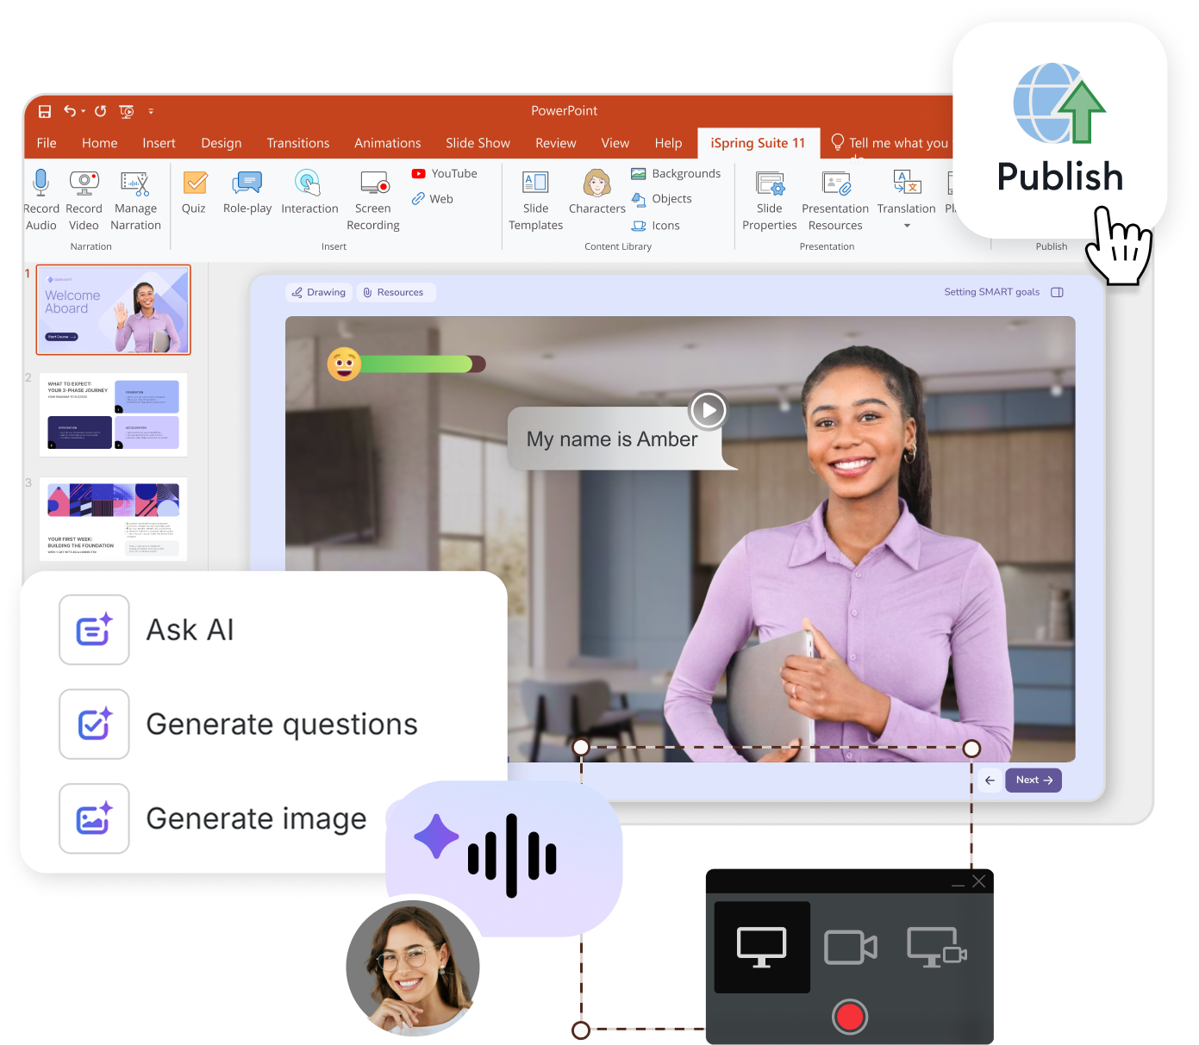
Create training you can confidently report on
Familiar authoring with no learning curve
Desktop and cloud content creation
Fast SCORM conversion and content reuse
Built-in AI for images, quizzes, voiceovers,
and translation
Section 508 and WCAG 2.1 AA compliant
Special pricing for educators, nonprofits, government organizations, and individual users
Book a live demo

Slide 9

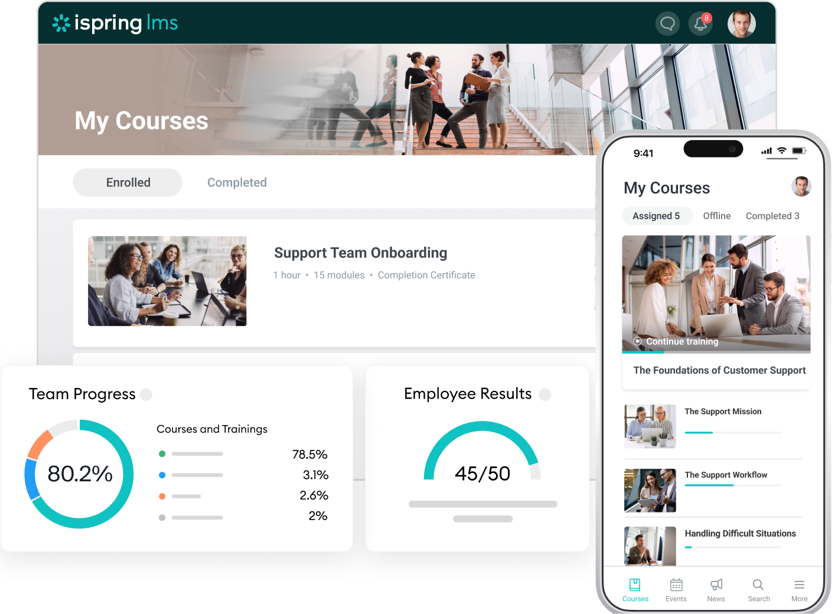
Tie learning to business results with iSpring LMS
Onboarding, compliance, sales training, and more
Talent evaluation and development
OJT modules to support real performance change
Supervisor dashboard and 25+ real-time reports
Consistent knowledge sharing across the company
Book a live demo

Slide 10





Welcome to the iSpring L&D community
Guides & templates →
️
Weekly webinars →
eLearning blog →
iSpring Learning Exchange →
YouTube channel →

