Slide 1




Course name: Diversity and Inclusion at the workplace
SLIDE 1 — Intro slide. Welcome to the course!
Voiceover
As more companies focus on diversity and inclusion, we must ask ourselves: "How can we create a safe and inclusive work environment where diverse groups of people can work together effectively?"
This course will explore possible answers to this question and give you a better understanding of what diversity and inclusion are all about.
Besides the narration, there's a relaxed background sound — Slide1_sound.mp3
* Blurred office background
Welcome to the course
Diversity and Inclusion
"Strength lies in differences, not similarities."
Stephen R. Covey
Programming notes
When a learner opens the course, background music will automatically start playing and, after three seconds, the audio narration will begin. When the audio is over, the slide changes. However, the learner has the option to press the "Pause" button if they want to stay on that slide longer.
* In the foreground, people of different ethnic and religious identities are holding hands and smiling.
Time to complete: 15 minutes
Next

Slide 2




Course name: Diversity and Inclusion at the workplace
SLIDE 2 — [Add the name or the purpose of the slide]
Voiceover
[Outline the audio narration of the slide: add text or file names. Use slide 1 as an example.]
Write the text that will appear on this slide.
Place it exactly where you want it.
Insert the necessary images for this slide,
or briefly describe what images will go where.
Map all buttons that need to be placed.
Programming notes
[Describe to the programmer how the slide works.]

Slide 3

Course name: Diversity and Inclusion at the workplace
SLIDE 3 — [Add the name or the purpose of the slide]
Voiceover
[Outline the audio narration of the slide: add text or file names. Use slide 1 as an example.]
Write the text that will appear on this slide.
Place it exactly where you want it.
Insert the necessary images for this slide,
or briefly describe what images will go where.
Map all buttons that need to be placed.
Programming notes
[Describe to the programmer how the slide works.]

Slide 4
Course name: Diversity and Inclusion at the workplace
SLIDE 4 — [Add the name or the purpose of the slide]
Voiceover
[Outline the audio narration of the slide: add text or file names. Use slide 1 as an example.]
Write the text that will appear on this slide.
Place it exactly where you want it.
Insert the necessary images for this slide,
or briefly describe what images will go where.
Map all buttons that need to be placed.
Programming notes
[Describe to the programmer how the slide works.]

Slide 5
Course name: Diversity and Inclusion at the workplace
SLIDE 5 — [Add the name or the purpose of the slide]
Voiceover
[Outline the audio narration of the slide: add text or file names. Use slide 1 as an example.]
Write the text that will appear on this slide.
Place it exactly where you want it.
Insert the necessary images for this slide,
or briefly describe what images will go where.
Map all buttons that need to be placed.
Programming notes
[Describe to the programmer how the slide works.]

Slide 6

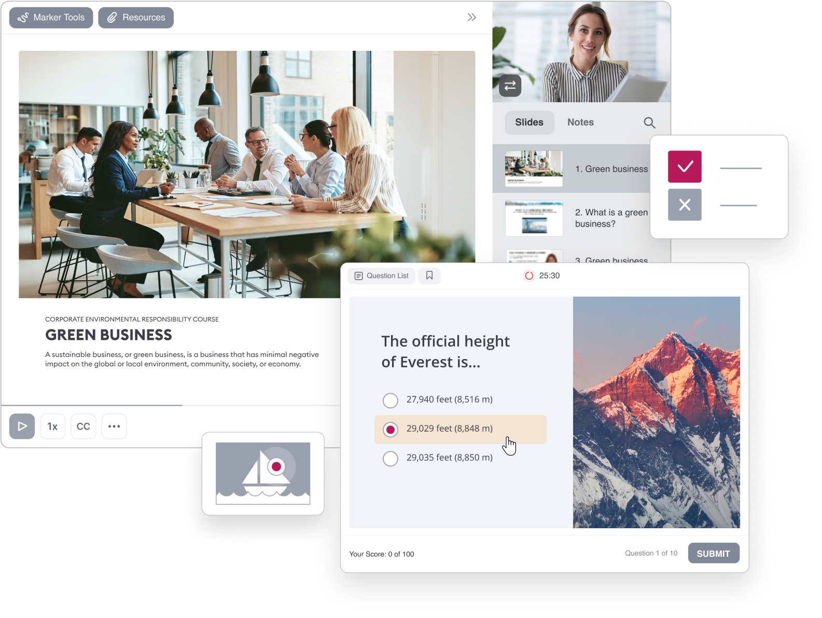





Bring your course storyboard to life in a snap
With iSpring Suite AI, a fully-featured eLearning content creation tool.
Turn PPT slides into SCORM courses
Generate eLearning content faster with the build-in
AI assistant
Build interactive quizzes and knowledge checks
Create dynamic role-play simulations with voiceovers
Record video lectures and tutorials, and much more
Download iSpring Suite AI for free
Learn more

Slide 7





Welcome to the iSpring Community!
Feel free to join and become a valuable part of a community of instructional designers and eLearning professionals who are taking training to the next level with iSpring.
Fast forward to the part of our community you like — just scan the relevant QR code.
LinkedIn L&D Community→
Blog →
Webinars →
Connect with others in your field, ask questions, share your own expertise, and take part in discussions.
Explore the exciting world
of eLearning together with our
helpful articles and how-tos.
Get eLearning tips
and tricks from top-notch
industry experts.
Guides →
YouTube →
Get step-by-step directions
on how to create and launch eLearning.
Enjoy weekly eLearning
videos and don’t forget
to subscribe.

