Slide 1
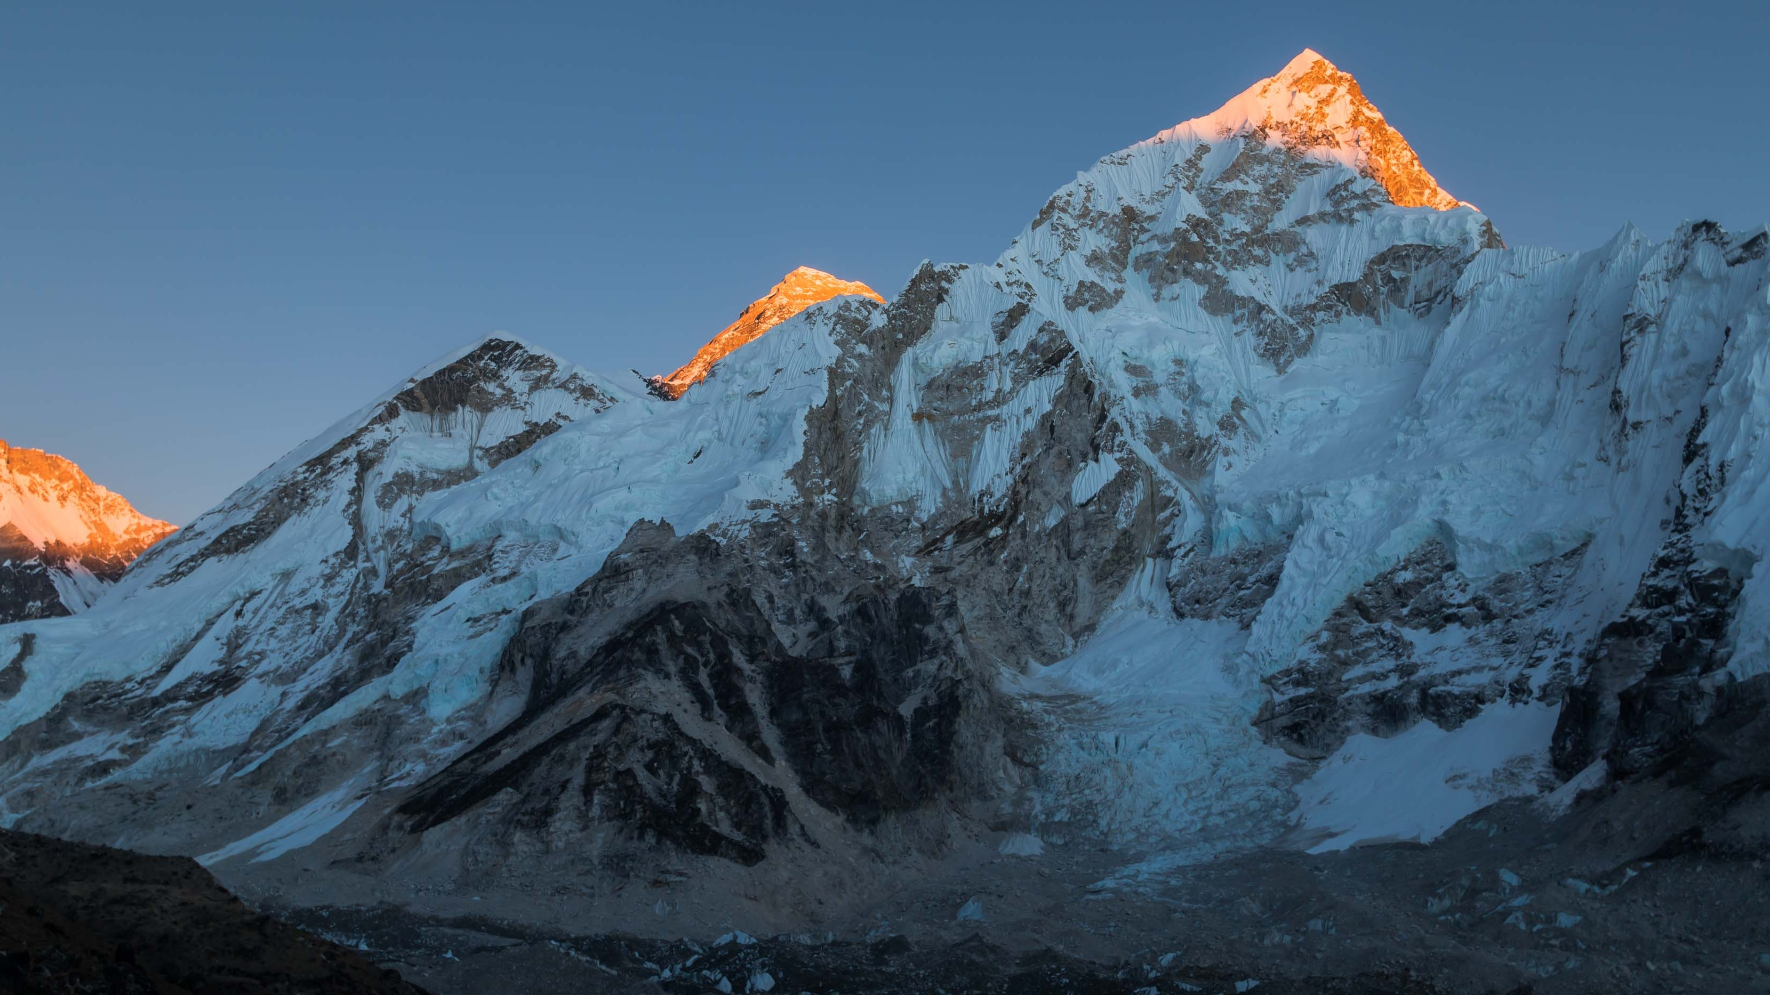
Mt. Everest Quiz
Thousands of people are dreaming to conquer Everest, but before even thinking about doing it, there’s so much to learn about the mountain!
Get started

Slide 2
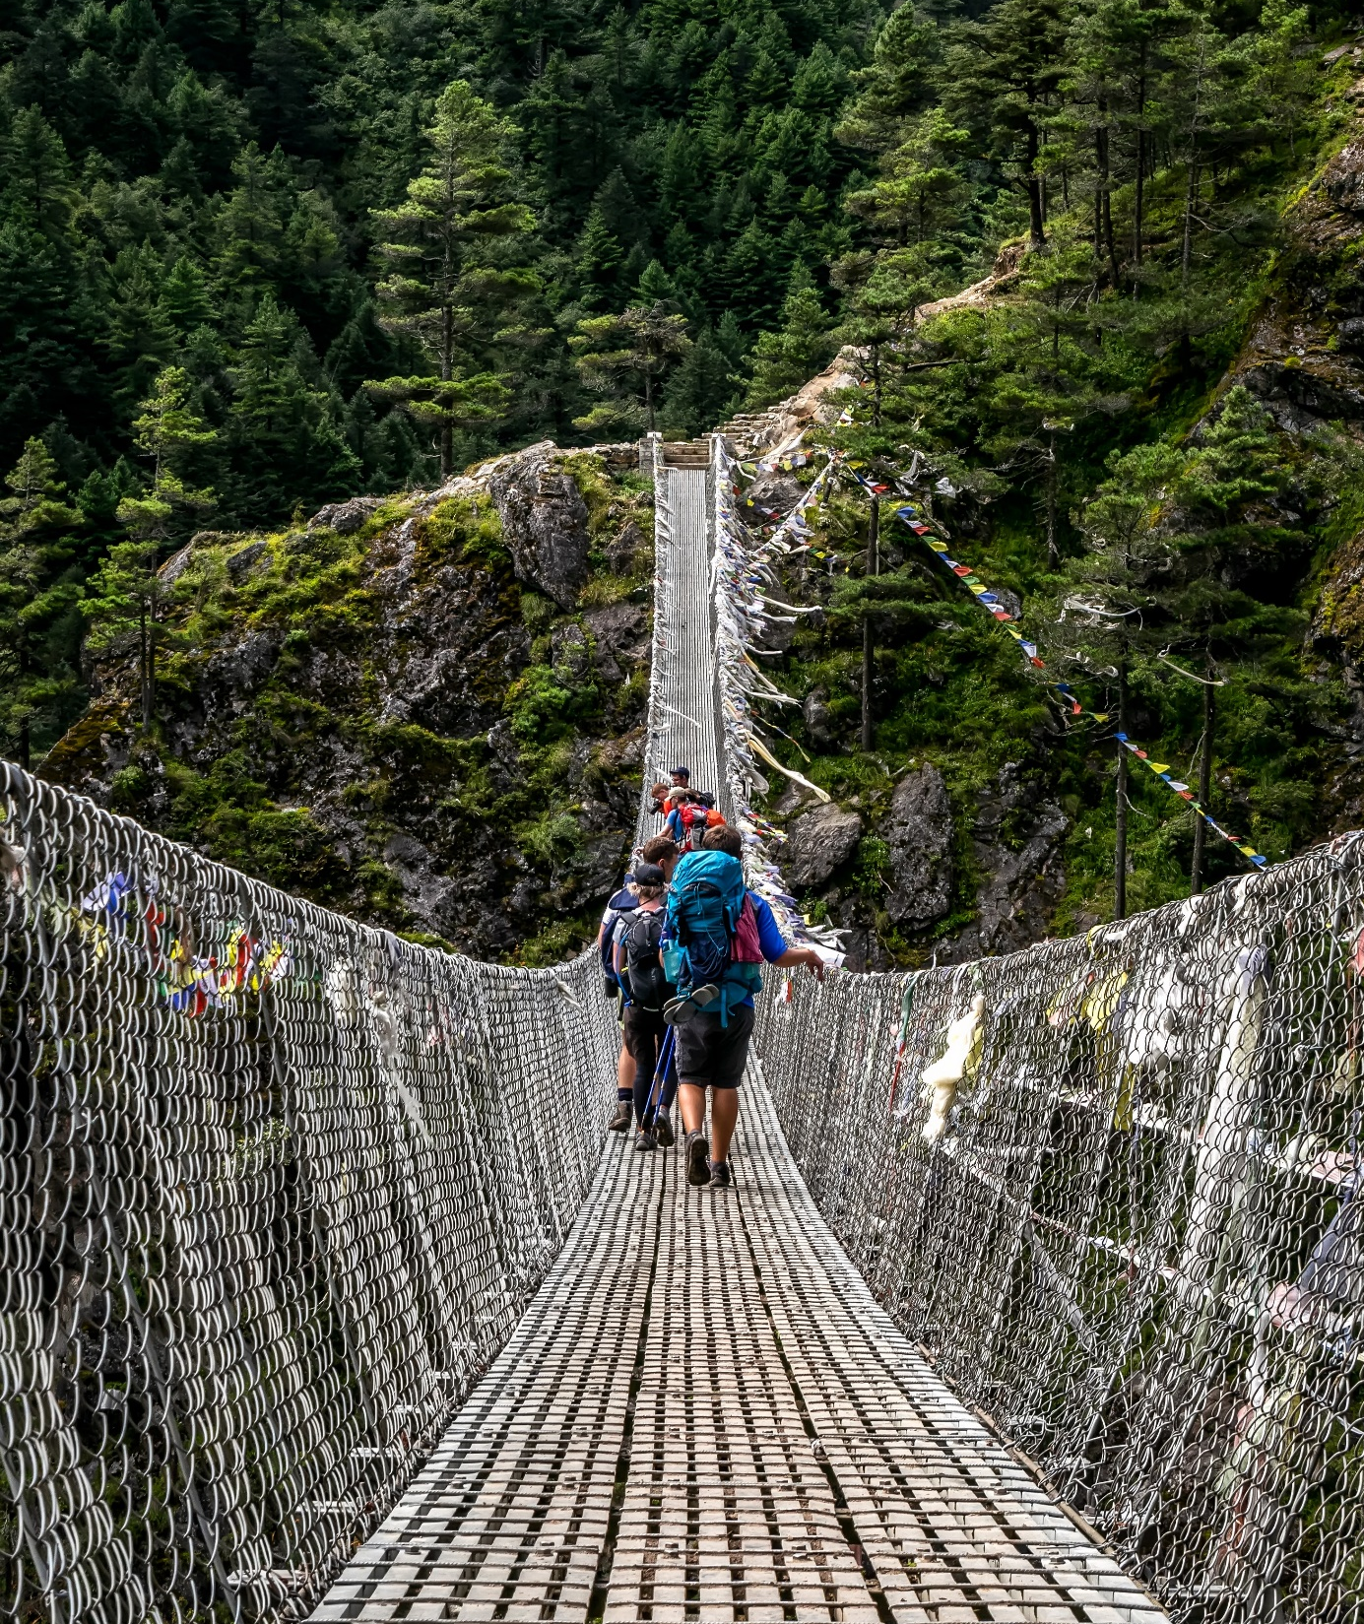
Everest’s summit point is located on the international border between these two countries:
Choose the answer
China and Tibet
Tibet and India
China and Nepal
Nepal and Bhutan
China and India

Slide 3
That’s right!
Continue quiz

Slide 4
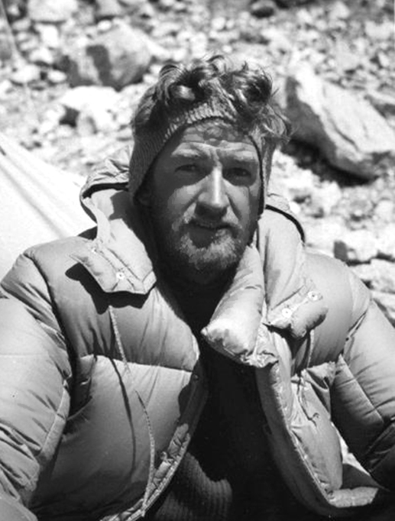
The mountain was officially named after George Everest, a retired Surveyor General who never even saw the peak.
Choose the answer
True
False

Slide 5
Oops, that’s wrong…
Try again
Continue quiz

Slide 6
That’s right!
That’s true! Sir George Everest was the leader
of the British survey team which officially established
the existence and the first published height of Everest.
Continue quiz

Slide 7
Oops, that’s wrong…
In fact, this is true. The mountain was named after
Sir George Everest, the leader of the British Survey team which officially established the existence
and the first published height of Everest.
Continue quiz

Slide 8
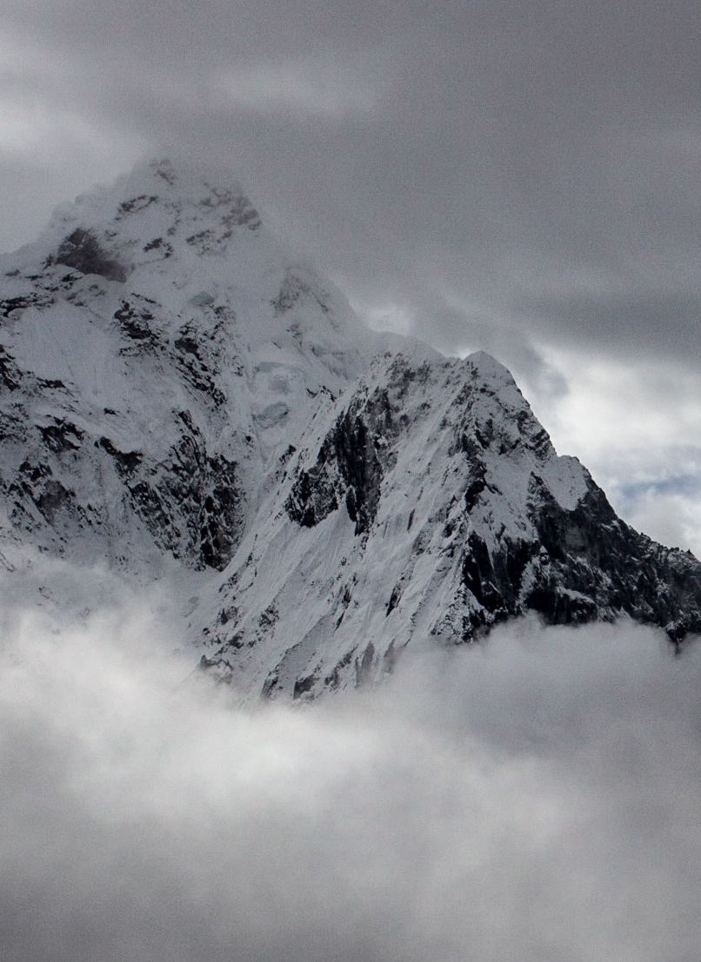
The official height of Everest is…
Choose the answer
29,029 feet (8,848 m)
29,035 feet (8,850 m)
27,940 feet (8,516 m)

Slide 9
That’s right!
Continue quiz

Slide 10
Oops, that’s wrong…
Try again
Continue quiz

Slide 11
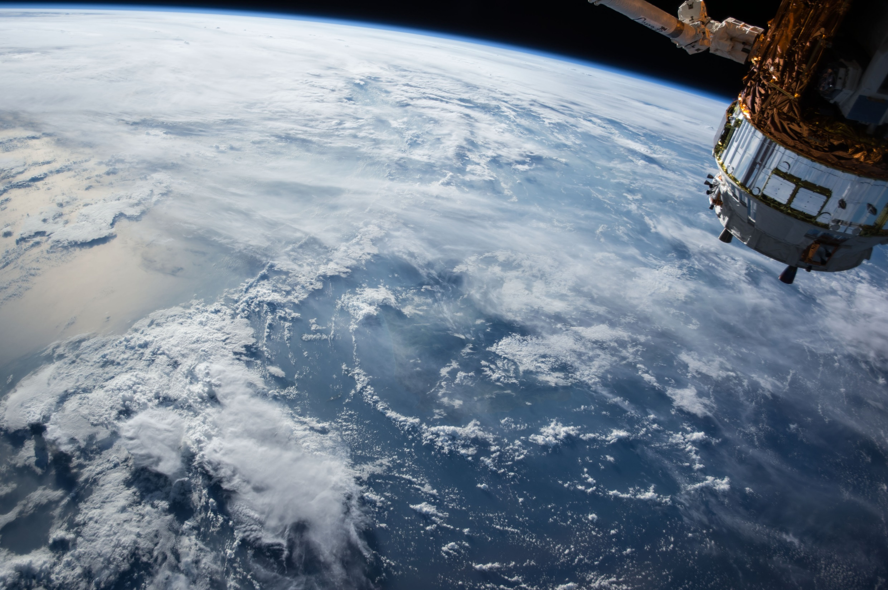
Choose the answer
Everest isn’t the furthest summit
from the estimated center of our planet.
True
False

Slide 12
That’s right!
That’s true! Due to the Earth’s equatorial bulge
(the difference between the equatorial and polar diameters of the planet), the summit of Mount Chimborazo in Ecuador is located further from
the center of the Earth than Everest’s summit,
even though Mount Chimborazo is only
20,561 feet (6,267 m) above sea level.
Continue quiz

Slide 13
Oops, that’s wrong…
Actually, it’s true! Due to the Earth’s equatorial bulge (the difference between the equatorial and polar diameters of the planet), the summit of Mount Chimborazo in Ecuador is located further from
the center of the Earth than Everest’s summit,
even though Mount Chimborazo is only
20,561 feet (6,267 m) above sea level.
Continue quiz

Slide 14
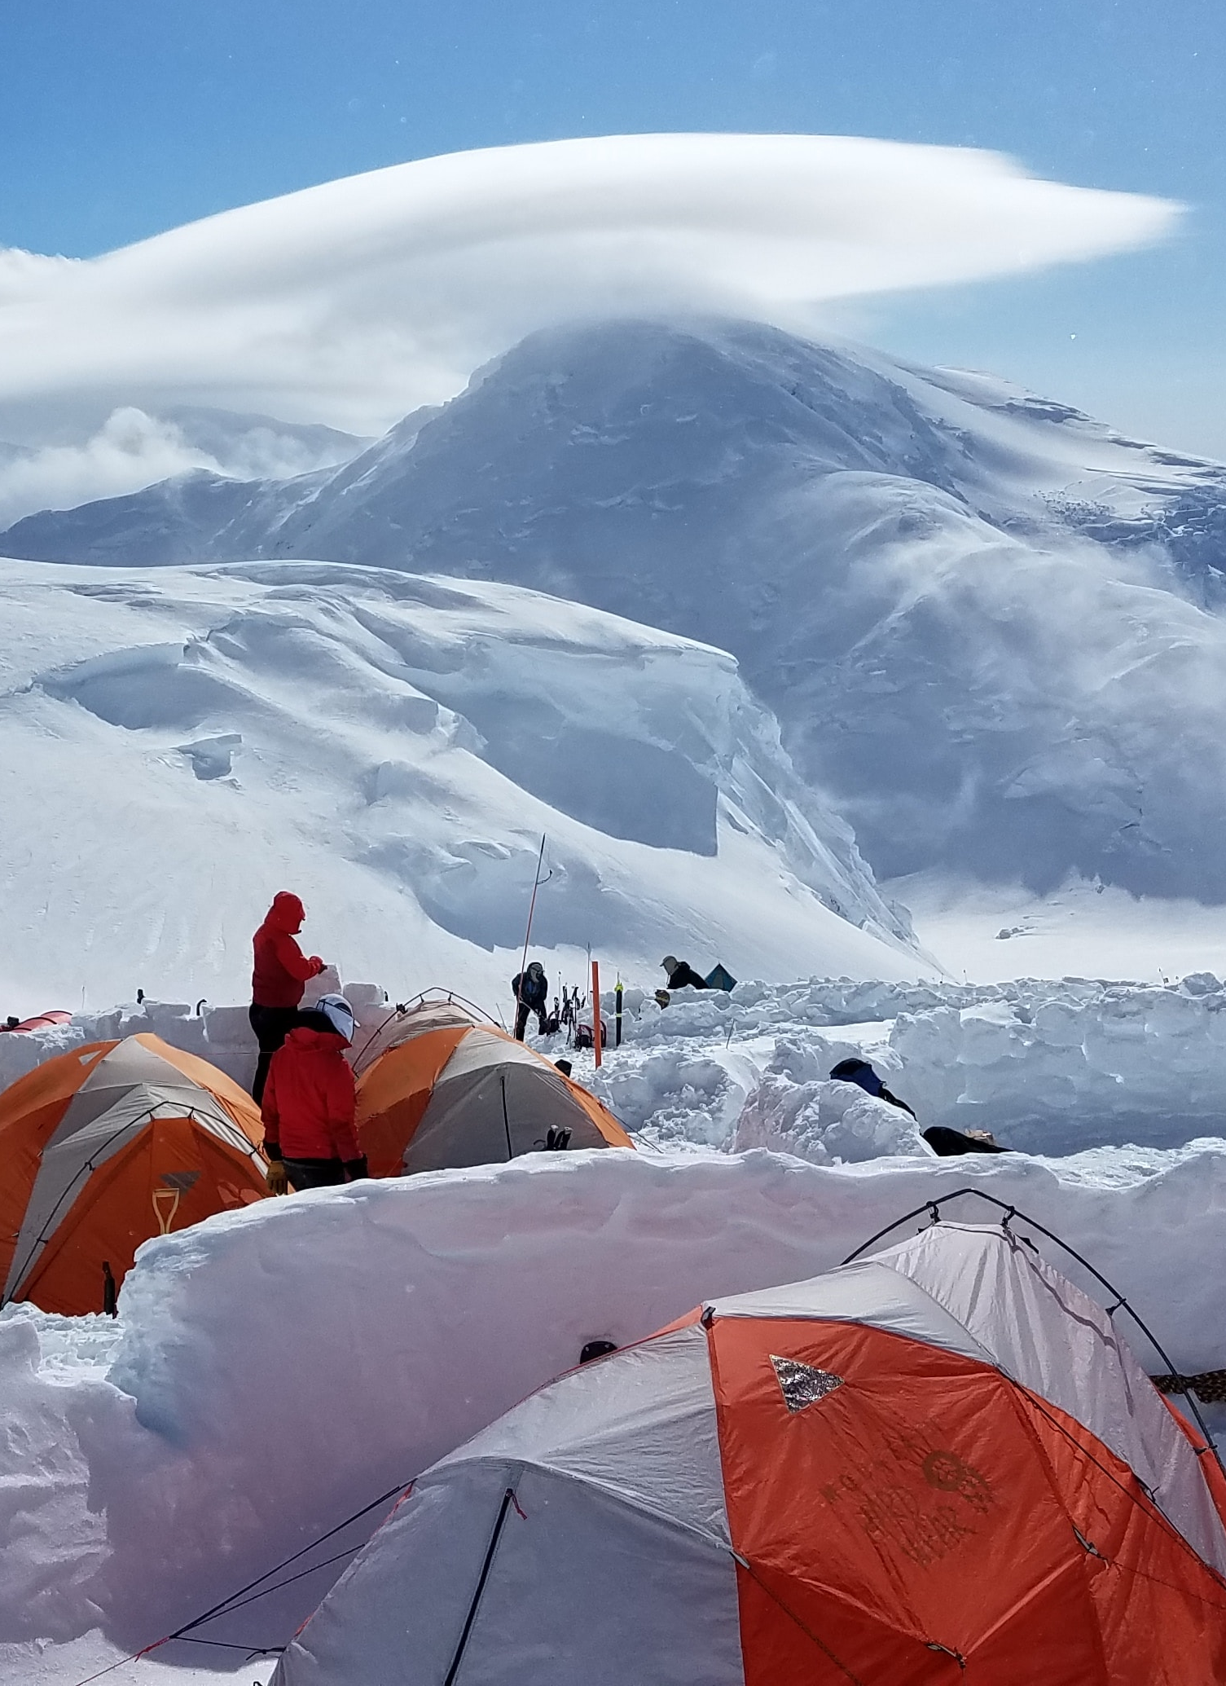
Choose the answer
It normally takes 12 hours to climb
the final mile from the highest
Base Camp to the summit.
True
False

Slide 15
That’s right!
Finish the quiz

Slide 16
Oops, that’s wrong…
Finish the quiz

Slide 17
The Mt. Everest
Quiz is over.
See you soon!

